Slide 1
Learning intention: To make tally charts.
You will need a pencil and some paper to write answers down.

Slide 2
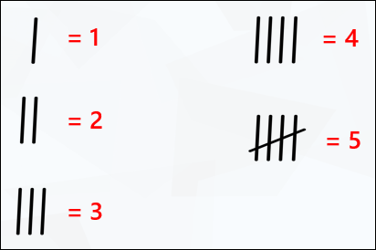
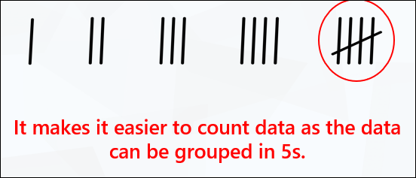
Tally charts are used to collect data or information quickly.
Each mark represents a number.
What does each tally represent?

Slide 3
Let’s count in fives using tallies.
5
10
5
10
15
20
5
10
15
20
25

Slide 4
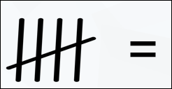
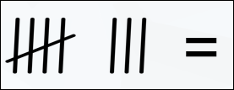
What does this tally represent?

Slide 5
Colour | Tally | Total
Red
Blue
Green

Slide 6
Colour | Tally | Total
Red |  | 4
Blue |  | 3
Green |  | 2

Slide 7
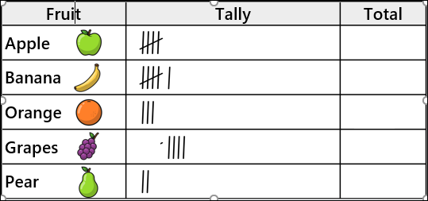

Slide 8
5
6
3
4
2

