Slide 1
Alternative Maths 1 Learning intention: To identify and describe the properties of 3D shapes including faces, edges and vertices.

Slide 3
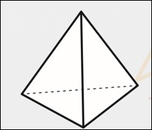
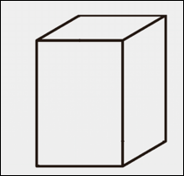
True or false? This is a cuboid.
True or false? This is a cone.
False. It is a pyramid
True

